Slide 1
Digital Transmission via Carrier Modulation
II

Slide 2
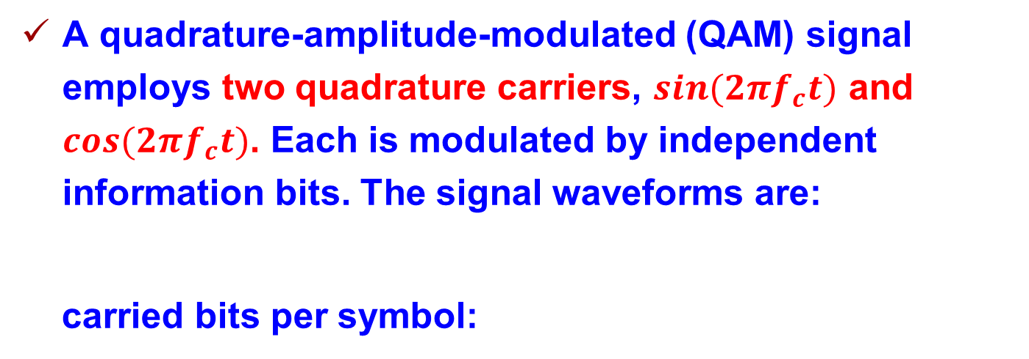
Quadrature Amplitude Modulation
A quadrature-amplitude-modulated (QAM) signal employs two quadrature carriers, $sin(2πf_{c}t)$ and $cos(2πf_{c}t)$. Each is modulated by independent information bits. The signal waveforms are:
carried bits per symbol:
A 16-QAM constellation each of whose quadrature carrier is modulated by M=4 PAM:

Slide 3
Quadrature Amplitude Modulation
More generally, QAM can be viewed as a form of combined amplitude and digital-phase modulation. We rewrite the QAM signal as:
carried bits per symbol:

Slide 4
Quadrature Amplitude Modulation

Slide 5

Quadrature Amplitude Modulation
Detection and demodulation of QAM signals:
The received signal:
where $φ$ is carrier offset and
The two correlators:
(normalized energy)

Slide 6
Quadrature Amplitude Modulation
The outputs from the two correlators:
where the noise components are zero-mean, uncorrelated Gaussian with variance
The opimum detector computes the distance metric:
where r=(r₁,r₂), s_{m}=(A_{mc},A_{ms}).
SER of rectangular QAM:

Slide 7
Quadrature Amplitude Modulation
Problem 7.6：Perform a Monte Carlo simulation of an M=16-QAM communication system using a rectangular signal constellation. The model is given as follows:

Slide 8
Quadrature Amplitude Modulation
UNG generates the sequence of information symbols corresponding to 16 poosible 4-bit combinations. The information symbols are mapped to the constellation points (A_{mc},A_{ms}):
The outputs from the correlator:
How to calculate average symbol energy?

Slide 9
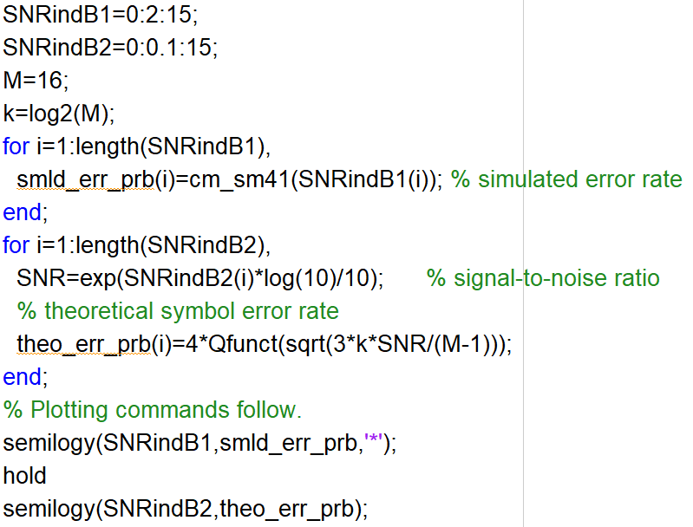
Quadrature Amplitude Modulation
Main script:

Slide 10
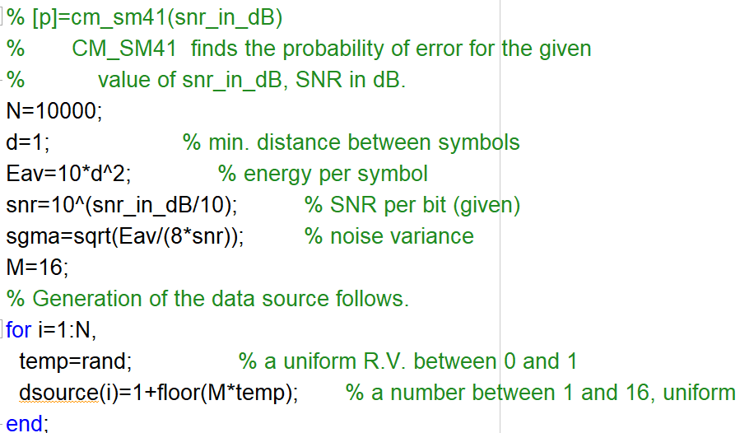
Quadrature Amplitude Modulation

Slide 11
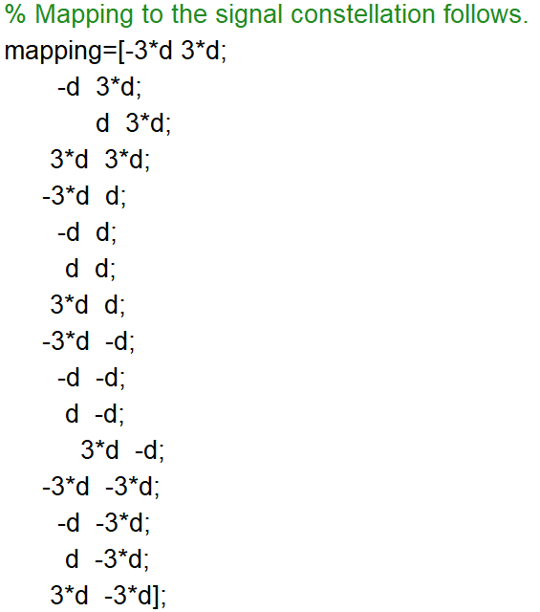
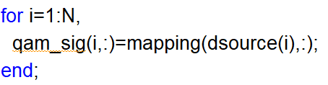
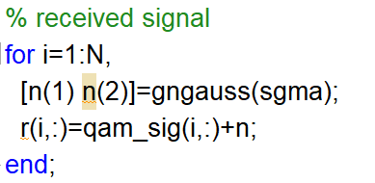
Quadrature Amplitude Modulation
s_{m}=(A_{mc},A_{ms})

Slide 12
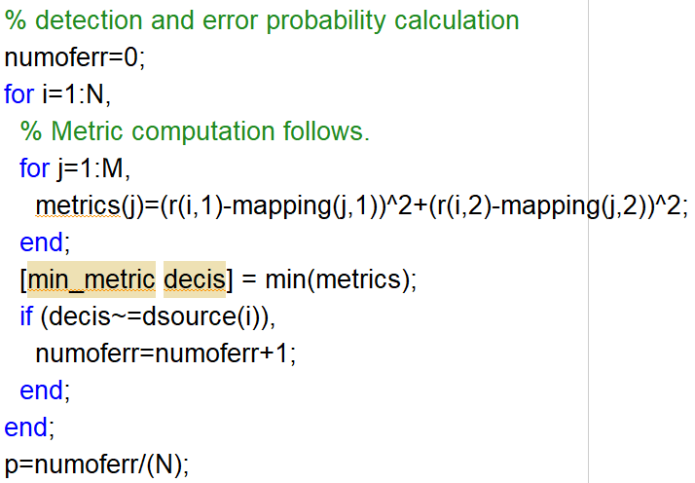
Quadrature Amplitude Modulation

Slide 13
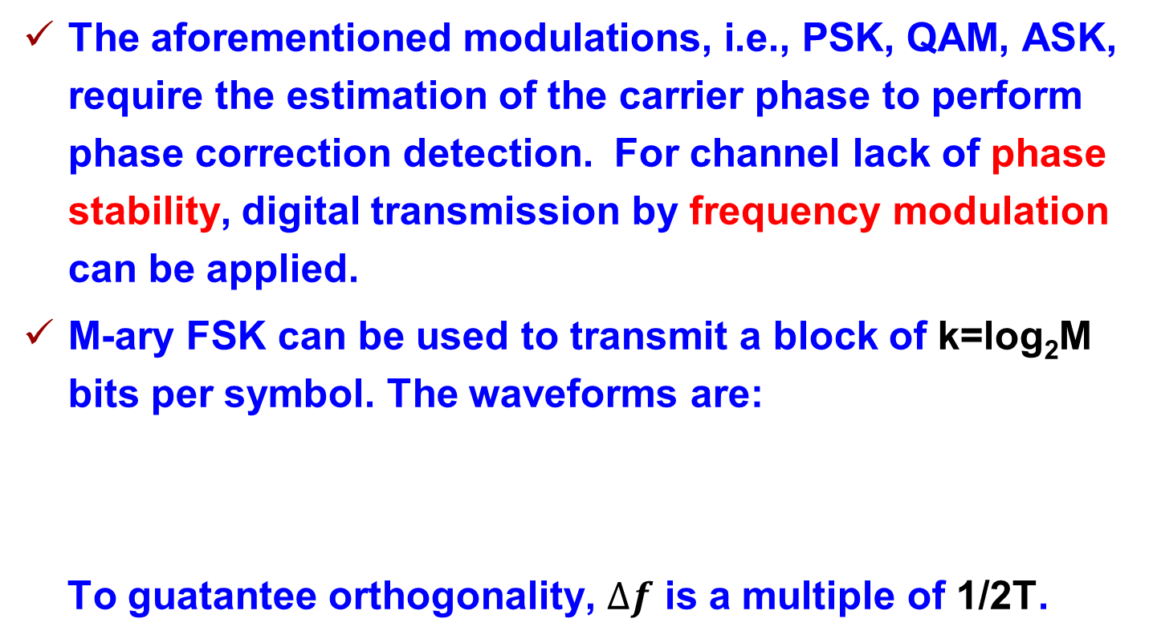
Carrier-Frequency Modulation
The aforementioned modulations, i.e., PSK, QAM, ASK, require the estimation of the carrier phase to perform phase correction detection. For channel lack of phase stability, digital transmission by frequency modulation can be applied.
M-ary FSK can be used to transmit a block of k=log₂M bits per symbol. The waveforms are:
To guatantee orthogonality, $∆f$ is a multiple of 1/2T.

Slide 14
Carrier-Frequency Modulation
To guatantee orthogonality, $∆f$ is a multiple of 1/2T.

Slide 15
Carrier-Frequency Modulation
Constellation diagram of M-ary orthogonal FSK waveforms:
where the basis signals are:
Minimal constellation distance:
Comparsion with ASK, PSK, QAM?

Slide 16

Carrier-Frequency Modulation
Detection and demodulation of FSK signals:
The received signal:
where $φ_{m}$ is carrier offset due to transmission delay.
Coherent demodulation:

Slide 17
Carrier-Frequency Modulation
The requirement to estimate M carrier phases makes coherent demodulation too complex.
Non-coherent demodulation:
The received signal is processed by 2M correlators. The basis signals for correlation are:
The 2M outputs from the correlator are: (the kth pair)

Slide 18
Carrier-Frequency Modulation

Slide 19
Carrier-Frequency Modulation
For the kth pair output, if k=m,
Otherwise:
The noise terms are i.i.d zero-mean Gaussian with variance
The optimial detector calculates:
And select the largest m.

Slide 20
Carrier-Frequency Modulation
Problem 7.7：Consider a binary FSK system:
Where f₁=1000/T_{b}, f₂=f₁+1/T_{b}. The channel imparts a phase shift . So the received noiseless signal is:
Numerically implement the correlation-type demodulator for the above signal.

Slide 21
Carrier-Frequency Modulation
The correlator demodulator multiplies the received signal with the following function and calculates the integral, respectively:
The detector is a square-law detector.

Slide 22
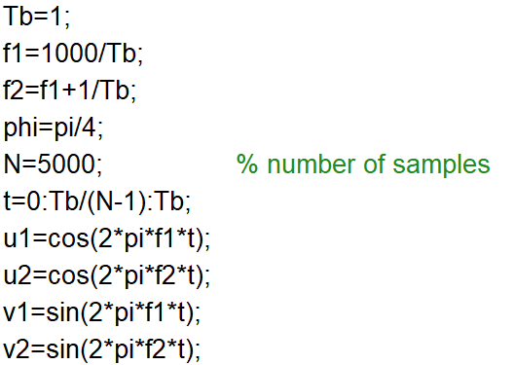
Carrier-Frequency Modulation
Initialization:

Slide 23
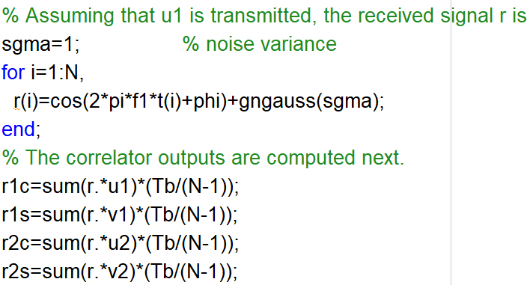
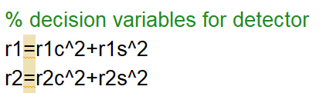
Carrier-Frequency Modulation
Received signal:
Detection:

Slide 24
Carrier-Frequency Modulation

Slide 25
Carrier-Frequency Modulation
Probabilty of symbol error for noncoherent detection of FSK:
When M=2,
BER:

Slide 26
Quadrature Amplitude Modulation
Problem 7.8：Perform a Monte Carlo simulation of a binary FSK
where and the detector is square-law detector.

Slide 27
Quadrature Amplitude Modulation
When u₁(t) is transmitted, the fisrt pair of correlators output:
The second pair outputs:
In the simulation, the channel-phase shift can be set to zero for convenience.

Slide 28
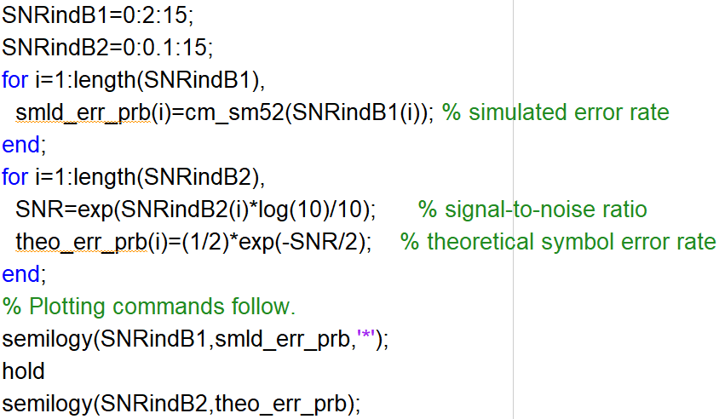
Quadrature Amplitude Modulation
Main script:

Slide 29
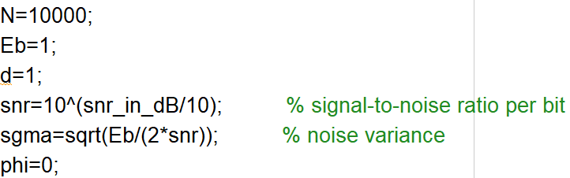
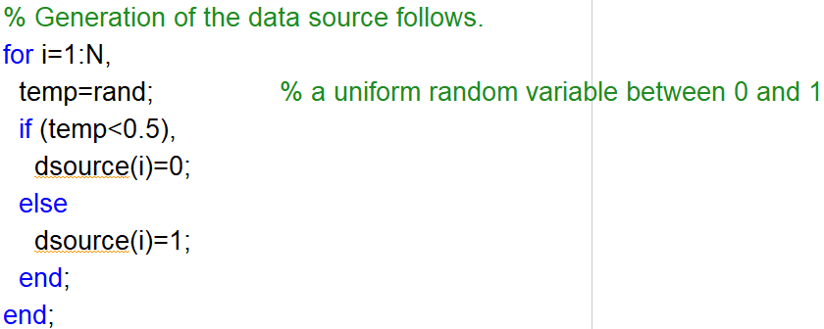
Quadrature Amplitude Modulation

Slide 30
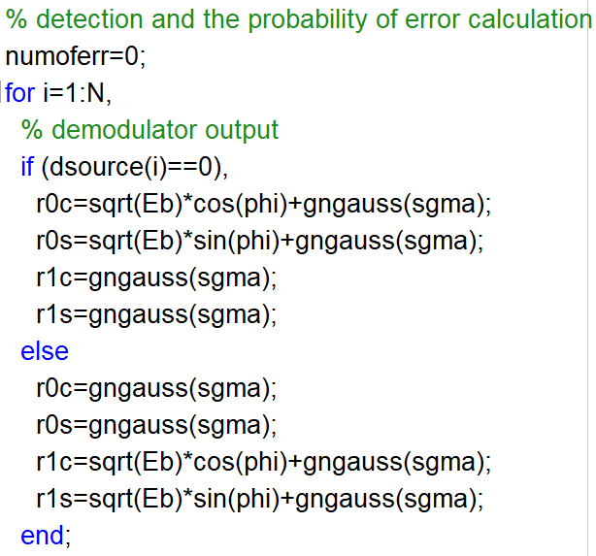
Quadrature Amplitude Modulation

Slide 31
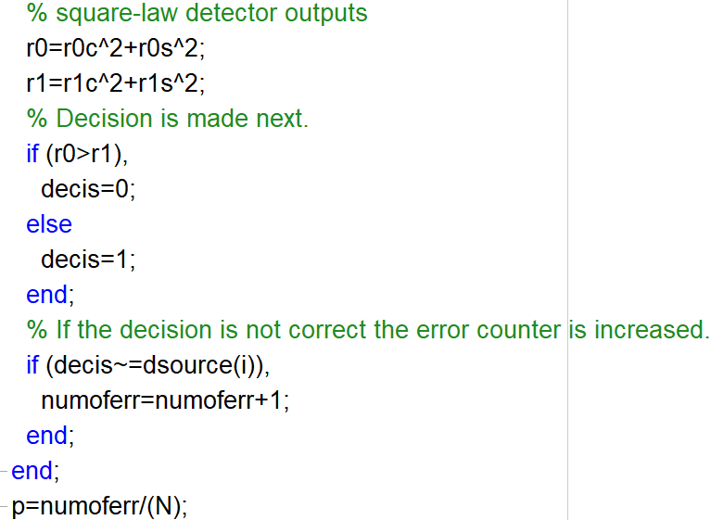
Quadrature Amplitude Modulation

